Slide 1


DATA 602 – Sneaker Market Resale Valuation
Eddie Xu

Slide 2
INTRODUCTION
SNEAKERS HAVE BEEN PROMINENT IN THE HIP HOP MUSIC INDUSTRY FOR DECADES AND NOW IT'S A CULTURAL PHENOMENON. WE NOW CALL THOSE WHO ARE PART OF THIS ONGOING TREND "SNEAKERHEADS." WITH THAT IN MIND, MULTI-MILLION DOLLAR BRANDS SUCH AS ADIDAS, NIKE, REEBOK, AND NEW BALANCE ARE THE LEADING COMPETITORS AND ARE PROFITING OFF LIMITED EDITION SNEAKERS THAT SELL UNIQUE COLORS, MAKES, AND SEASONAL FOOTWEAR.
RESEARCH QUESTION:
WHAT IS THE MOST VALUED SNEAKER IN THE AFTER MARKET BACK IN 2019?
WHAT IS THE MOST VALUED SNEAKER IN THE AFTER MARKET IN 2023?

Slide 3
DATA SOURCE & LIBRARIES
DATA SOURCE:
2023 DATA: HTTPS://WWW.KAGGLE.COM/DATASETS/AJIARON/STOCKX-SNEAKER-DATA
2019 DATA: HTTPS://WWW.KAGGLE.COM/DATASETS/HUDSONSTUCK/STOCKX-DATA-CONTEST
LIBRARIES POTENTIALLY BEING USED.
PANDAS: SINCE THE DATA SOURCE IS FROM CSV FILES, THE LIBRARY IS NEEDED FOR ETL PROCESS.
NUMPY: THE LIBRARY IS NEEDED SINCE CALCULATIONS WILL BE USED TO DETERMINE THE SNEAKER VALUE
SEABORN: THE LIBRARY IS NEEDED TO DEVELOP DATA VISUALIZATIONS AND VIEWS.

Slide 4

ABSTRACT
For the past twenty years, streetwear or high valued sneakers such as Yeezy Boosts, Air Off White or Air Jordans’ became a prized possession in the sneaker community and increased in value over time. To examine the after market value in such shoes, the data sets from 2019 and 2023, were extracted and cleansed for data calculations to find the difference in resale prices. The datasets include the brand, sneaker name, retail price, and sale price. Using this datasets, the market value change is calculated by the difference of the sale price from the retail price.
The results in this data shows that since the market became more of a fast fashioned pace, then the value of the sneakers that were once “high value” in 2019 is significant in 2023, but there is a decrease in the resale value. The regard for these esteemed sneakers have depleted due to the rise in wanting more color waves and more celebrity collabs play a huge role. Since media is always changing who is the best rapper, sports player, or luxury brands such as Dior, Supreme, and Fragments, the wants of the consumer changes as the above external factors change.

Slide 5
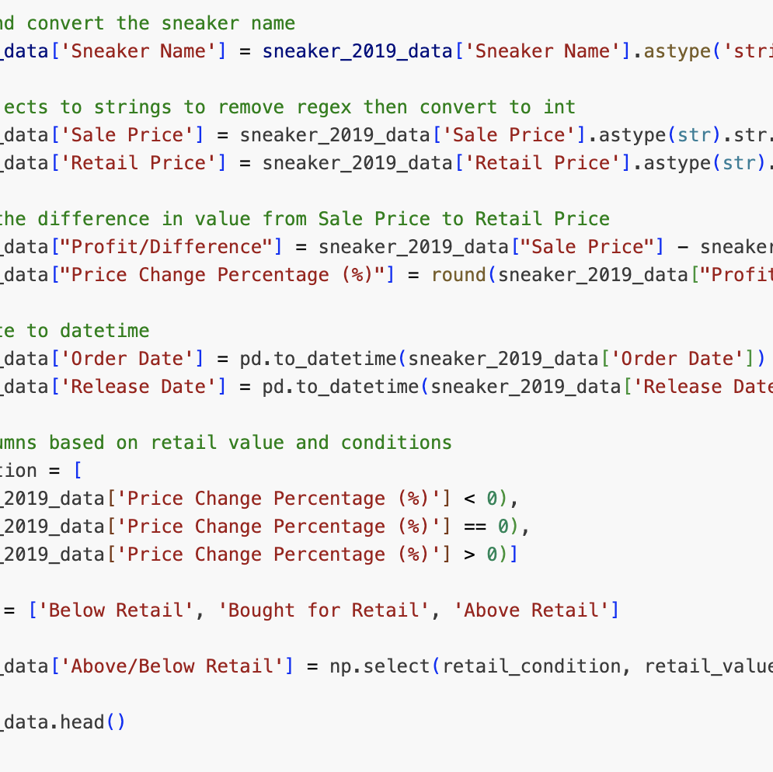
DATA WRANGLING
REMOVE ALL REGEX
CHANGED DTYES FOR SNEAKER NAME, ORDER DATE, RELEASE DATE TO REPESECTIVE TYPES
DETERMINED EACH SNEAKERS IF IT IS ABOVE OR BELOW RETAIL PRICES ON 2019 AND 2023 DATA.

Slide 6
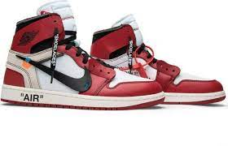
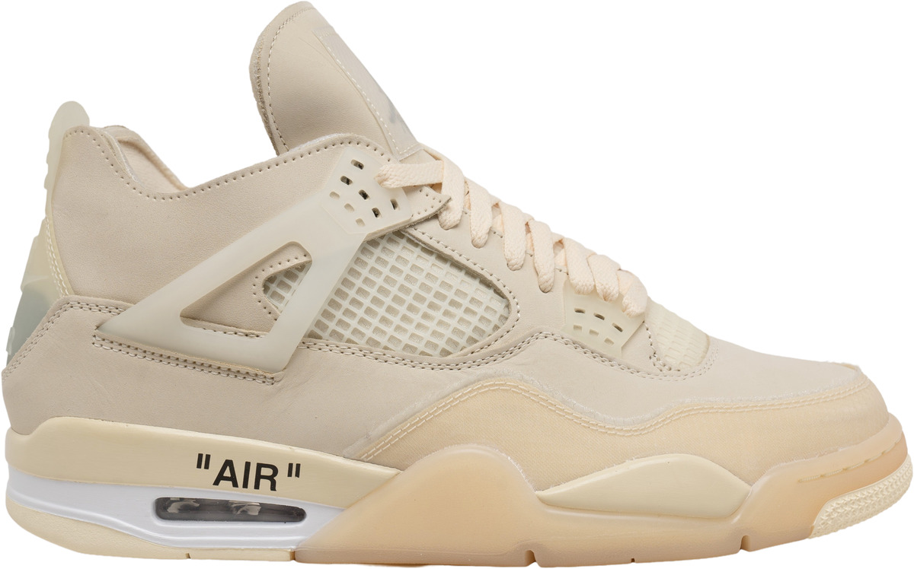
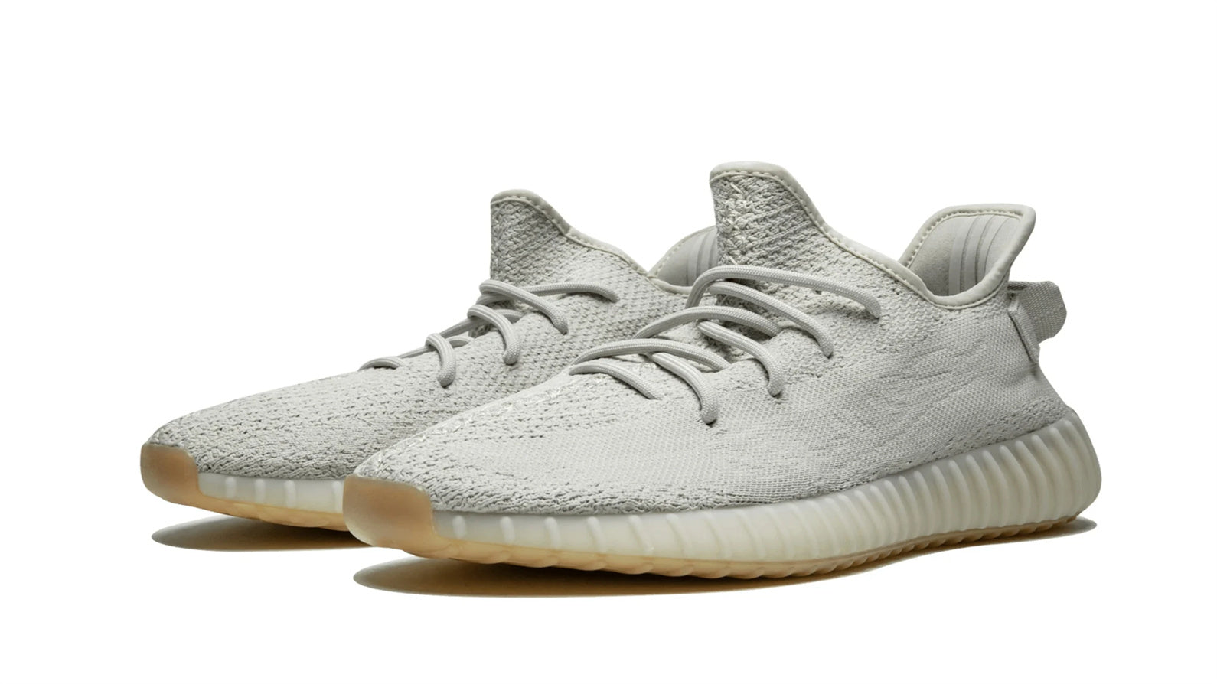
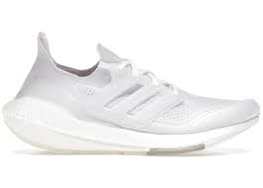
DATA ANALYSIS
THE RESALE VALUED SNEAKER IN 2019:
AIR JORDAN 1 RETRO HIGH OFF WHITE CHICAGO (SOLD FOR $4050)
ADIDAS YEEZY BOOST 350 V2 SESAME (SOLD FOR $545)
THE RESALE VALUED SNEAKER IN 2023:
AIR JORDAN 4 RETRO OFF WHITE SAIL (W) (SOLD FOR $4050)
ADIDAS ULTRA BOOST 21 TRIPLE WHITE (SOLD FOR $154, BELOW THE RETAIL)

Slide 7
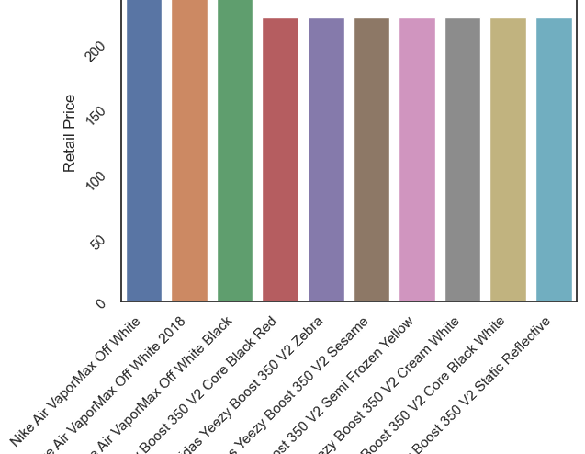
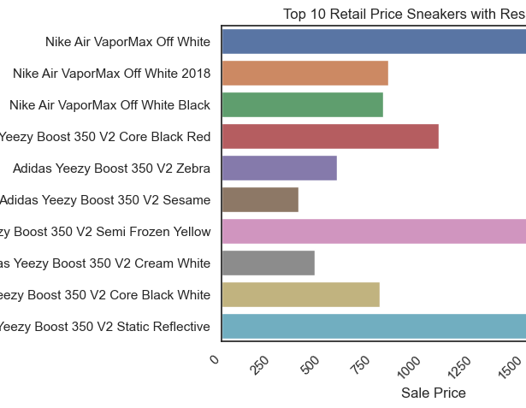
TOP 10 RETAIL PRICED SNEAKERS (2019)

Slide 8
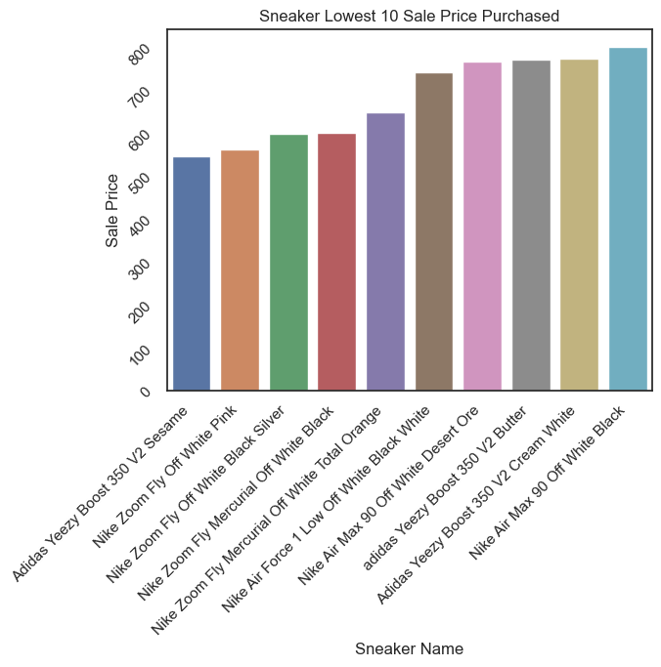
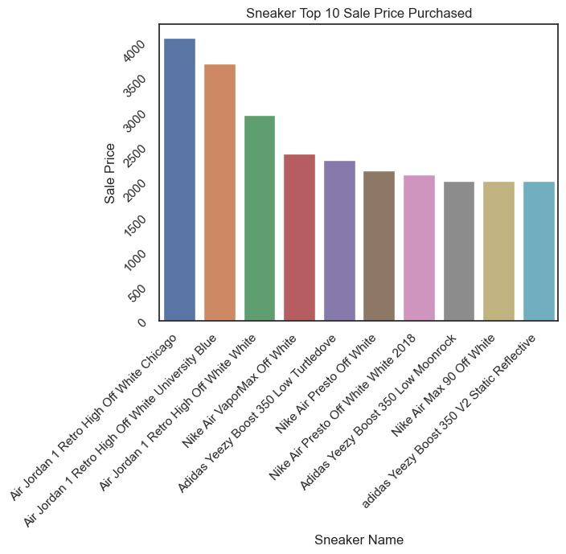
TOP 10 AND LOWEST 10 SNEAKERS(2019)

Slide 9
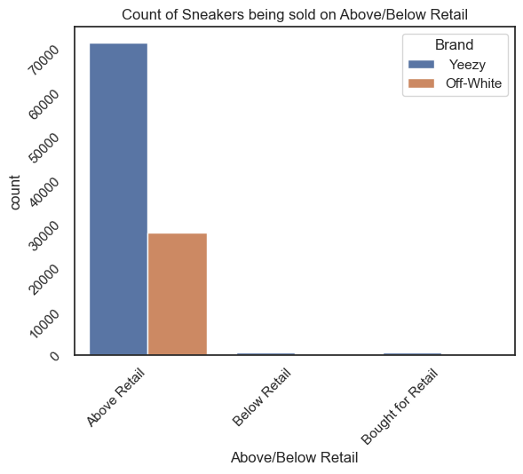
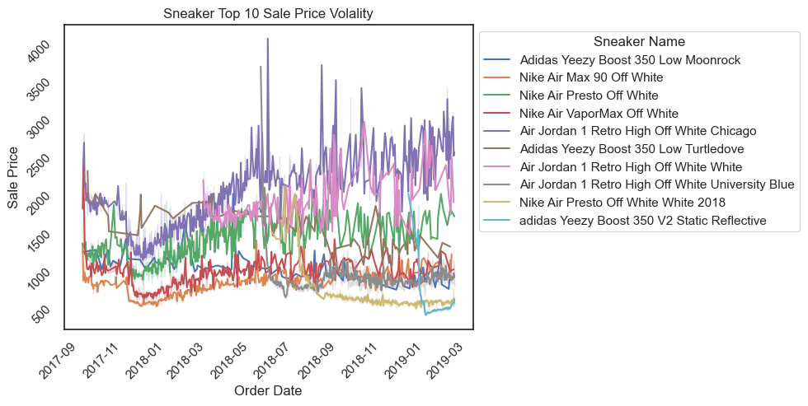
RESALE VOLALITY (2019)

Slide 10
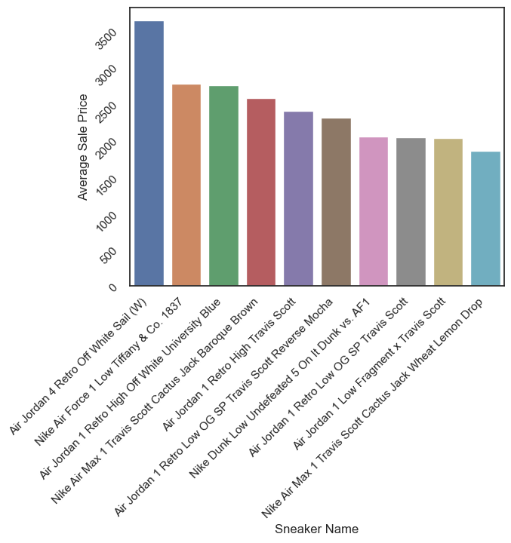
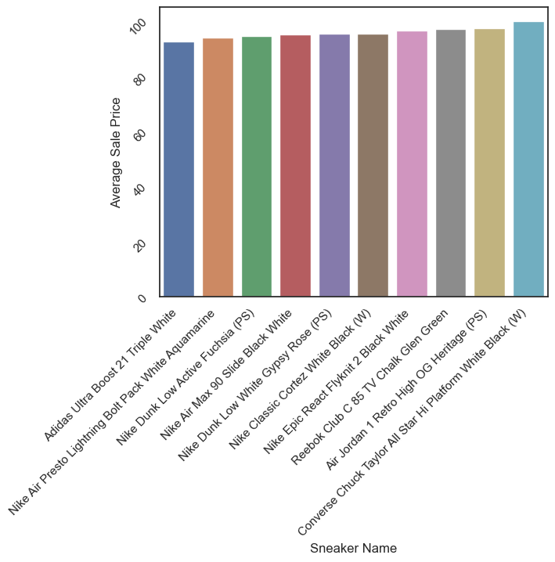
TOP AND LOWEST 10 SNEAKERS (2023)

Slide 11
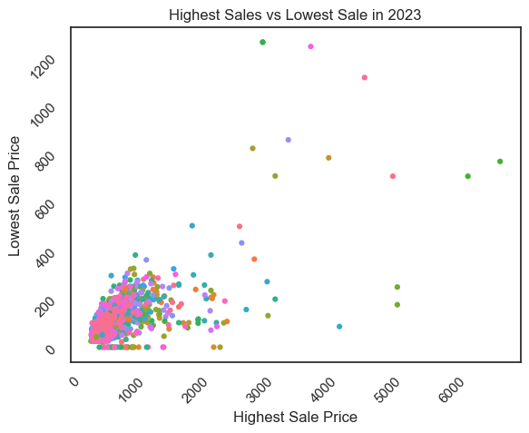
RESALE VOLALITY (2023)

Slide 12
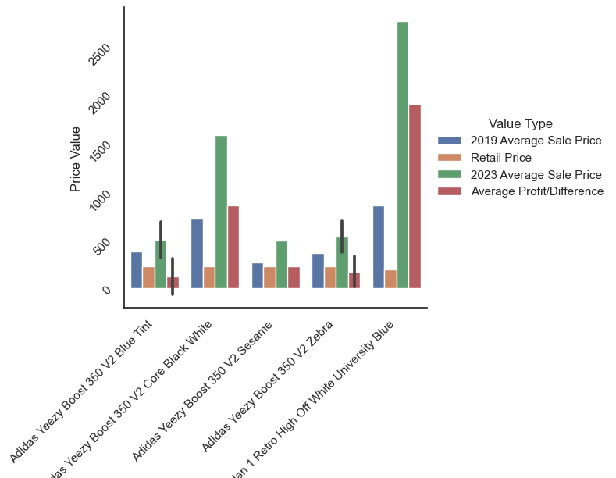
COMPARSION ON SNEAKERS VALUE

Slide 13

CONCLUSION
THE RESALE MARKET SIGNIFICANTLY CHANGED.
THE MARKET IS OVERSATURATED.
BRAND RECOGNITION
THE INTEREST IN SNEAKERS WENT DOWN DUE TO ECONOMY AND GENERATIONAL DIFFERENCES.
CONSUMERS WILL BUY LESS IN THE FUTURE.

